Slide 1
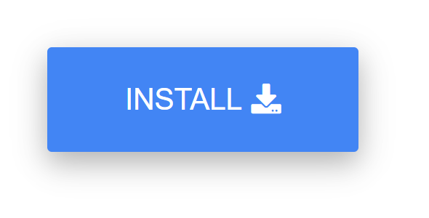
Install Sam's toolkit
Verify that Sam's toolkit add-in.ppam is in the same directory as this file
Enable macros if required:
Run installer macro in either of the ways:
  Press ALT + F8, select InstallSamsToolkit and click Run
  Start slide show and click the installation button below

